Slide 1
rates
Year 7

Slide 2
Learning Intentions
Students will be able to
Simply rates
Use rates to solve real-world problems

Slide 3
Rates Quickwrite
What do you know about rates?
List as many examples of rates that you know. One example is km/h
You have 2 mins
BE PREPARED TO SHARE

Slide 4
24
7
30
Topic: Rates
Date:
EQ – How do we use rates?
What is a rate?
A comparison of quantities of different types
Example: Rent is $350 per week
dollars
time
In this example we are comparing money and amount of time
What is simplifying a rate?
Rates need to be simplified (divided) so that one quantity is 1
(and we write this as per)
per week is 1 week
per hour is 1 hour
per kg is 1 kg

Slide 5


Slide 6
Guided Practice
Level 1
$10 for 2 apples
Level 2
$40 for 20 L of fuel
Level 3
220 ml or rain in 4 months
Notes:
Guide students through these questions.
The goal is to have 80% of the students okay with level 1 and level 2.

Slide 7
Task
Level 1 Level 2 Level 3
100 m in 10 seconds
________m per second
b. 25 min for 5 pizzas
_______ min per pizza
20 L in 2 minutes
_________ L per minute
240 beats in 4 minutes
b. 275 marks in 5 tests
7000 people in 200 buses
40 points in 5 games
b. 120 litres in 60 seconds
250 apples in 50 bags
Everyone start with Level 1 and see how far you can get in 5-7 minutes! If you finish early, help someone next to you!

Slide 8
24
7
30
Topic: Rates
Date:
EQ – How do we use rates?
How can we use rates to solve problems?
Once a rate is written as per something we can then use multiplication for different scenarios
Original Example: Rent is $350 per week
dollars
time
We know how much rent is for 1 week
What if we wanted to know how much it would cost for 2 weeks?
$350 × 2 = $700
What if we wanted to know how much it would cost for 5 weeks?
$350 × 5 = $1,750

Slide 9
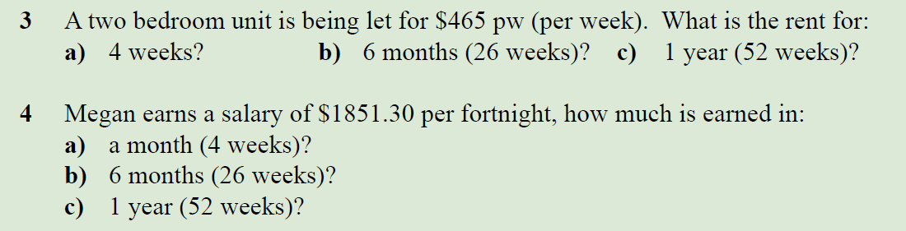
Task

Slide 10
Summary
A rate is a ____________ of two ____________
We use rates to solve problem such as _____________________

Slide 11
Lesson 2 rates unitary method
Year 7

Slide 12
Learning Intentions
Students will be able to
Apply the unitary method
Use rates to solve real-world problems

Slide 13

Simplify these rates
30m in 3 mins becomes 10m per minute

Slide 14
24
7
30
Topic: Rates
Date:
EQ – How do we use the unitary method to solve rate questions?
What is unitary method
Writing a rate as a quantity per one unit of another quantity
This is useful for comparing prices
How do we use the unitary method?
Which is the best buy?
$4.80 for 2 kg of potatoes
Or
$10.20 for 5 kg of potatoes
Steps:
Write each rate as a rate per one unit (simplify the units)
2. See which one is cheaper (the best buy
$4.80 per 2kg becomes $2.80 per 1kg
$10.20 per 5kg becomes $2.04 per 1kg
Therefore the $10.20 for 5kg is the best buy

Slide 15
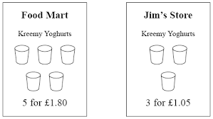
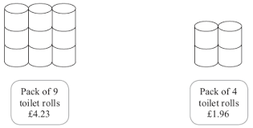

Some more examples

Slide 16
Dwyer text book page 54 Question 3 and 4

Slide 17
Summary
We can use the _________________ to compare rates. This can be useful when comparing ________________.
To use the unitary method we first write ___________as the amount per __________ and then see which is __________.

